Slide 1



Indiana University–Purdue University Indianapolis
INFORMATICS PROJECT
MANAGEMENT
MD SAMEER, NEHA, PARVATHI, SRIJA, AISHWARYA, FANNY
GROUP 6

Slide 2
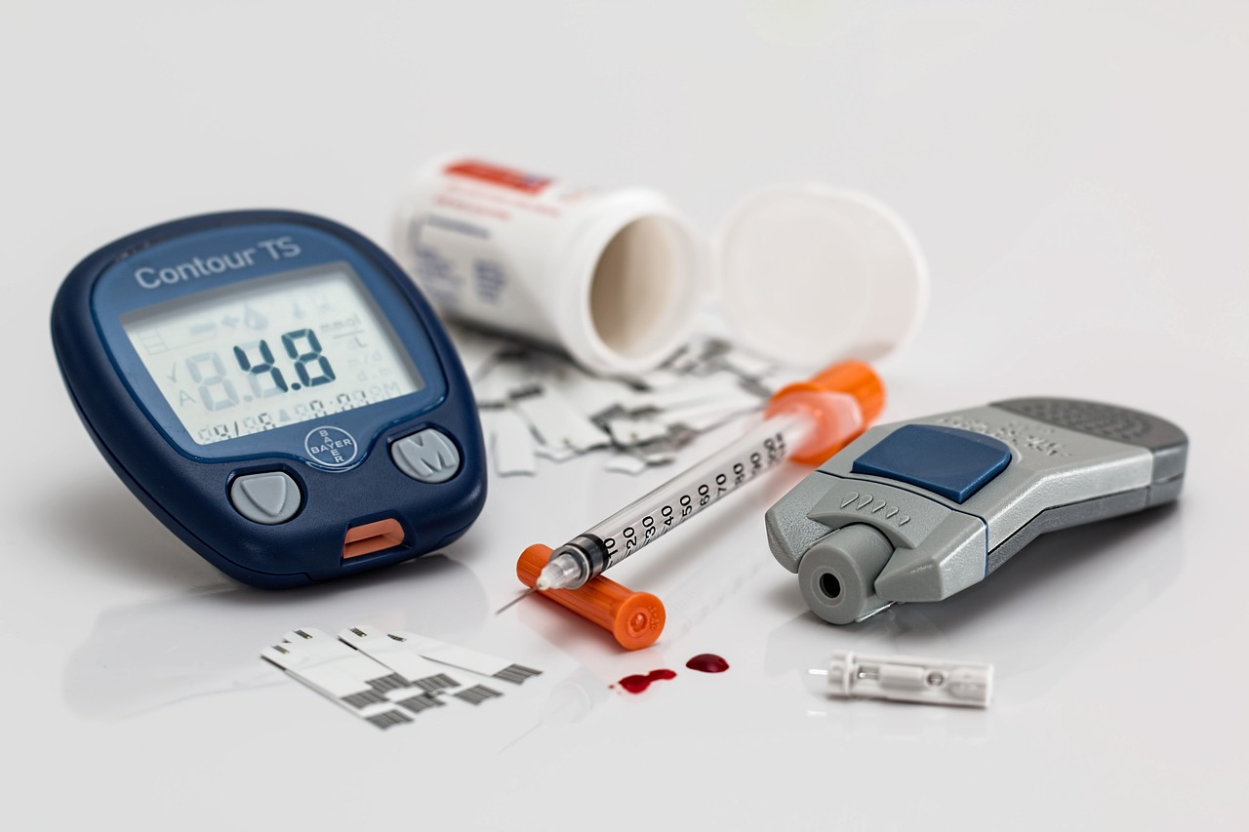
TOPIC
A RESEARCH STUDY ON EFFECTIVENESS OF CURRENT REMOTE INSULIN DEVICES

Slide 3
The growing prevalence of diabetes, with over 537 million adults afflicted worldwide, according to the International Diabetes Federation’s latest estimates, highlights an urgent need for improved monitoring and disease management solutions. Suboptimal blood sugar control puts patients at high risk for complications like kidney disease, blindness, and even limb amputations.
Remote patient monitoring technology can provide enhanced continuity of care beyond clinical environments. However, with many insulin delivery devices in the market, an objective analysis is imperative to evaluate accuracy, reliability, usability, and cost-benefits to guide adoption.
Selecting 5 prominent remote insulin monitoring devices on the market based on capabilities and technology
Conducting controlled tests on recruited participants to collect accurate device performance data
Comparing devices on metrics of accuracy, ease of use, and costs through statistical analysis
Evaluating real-world viability by incorporating patient feedback on usability and convenience
Formulating evidence-based recommendations on most effective device(s) to guide stakeholder decision-making and technology investments in diabetes care
SCOPE:
The critical focus areas in the scope are:
Choosing 5 appropriate devices
Rigorous testing protocols
Quantitative and qualitative analysis of multiple parameters
Assessing clinical relevance and practical application
Enabling data-driven decisions on optimal solutions,
1.INTRODUCTION
Notes:
Hello im sameer

Slide 4

2.WORK BREAKDOWN STRUCTURE
Phase 1 - Planning and Selection
Literature review
Assemble project team
Develop testing protocols
Create data collection plan
Define device selection criteria
Identify potential devices
Screen and select 5 devices
Develop study methodology
Create budget and timelines

Slide 5
BUDGET
PHASES | BUDGET | REASON FOR EXPENDITURE
INSTALLATION | $24,000.00 | Equipment setup, Safety measures, Calibration of Monitoring devices, Contingency costs
PLANNING | $56,000.00 | Ethics approval and regulatory compliance, Data collection plan, Research team training
TESTING | $98,000.00 | Testing equipment, Data collection, Data analysis, Quality assurance, Research staff salaries
DELIVERY | $51,000.00 | Stakeholder engagement, Dissemination of research findings, Report writing, and publication
Total-$229,000.00 | Total-$229,000.00

Slide 6

3. BUDGET
Installation Phase Budget
The installation phase spanning project initiation carries an allocation of $50,000. This covers onboarding a cross-functional team, vendor evaluations for test devices, and early planning workflows to design the study protocol.
Planning Phase Budget
The planning leg entailing study design, methods finalization, and securing regulatory approvals requires $135,000. Major expenses are procuring test devices, incentives for participants meeting the demographic criteria, and simulating real-world testing conditions.
Testing Phase Budget
Execution of controlled device trials during the testing phase has a budget of $70,000. This includes costs for test equipment, disposables, and effort to validate collected data on accuracy and usability parameters rigorously.
Delivery Phase Budget
The concluding delivery phase has a budget envelope of $50,000 earmarked for analysis, documentation and reporting of findings, recommendations, and tracking performance metrics after deployment in care settings. Reserves are allocated within each bucket.

Slide 7
Okay, let me update the budget information using the actual values from the project documentation instead of estimated budgets: 1. Phase One Budget The budget for Phase One planning and selection is $. This covers the project manager ($10,000), research team ($25,000), stakeholder engagement ($5,000), resource materials ($5,000), and miscellaneous expenses ($5,000). 2. Phase Two Budget The Phase Two testing and data collection budget is $135,000. This includes project manager ($15,000), research team ($50,000), participant compensation ($10,000), device purchase ($30,000), lab equipment and consumables ($20,000), and miscellaneous expenses ($10,000). 3. Phase Three Budget The Phase Three analysis and reporting budget is $70,000. This covers the project manager ($10,000), research team and analysts ($40,000), statistical analysis software ($10,000), stakeholder engagement ($5,000), and miscellaneous expenses ($5,000). 4. Total Budget The total actual budget allocated for the project across all three phases is $255,000. Let me know if you need any other changes to use the real budget numbers from the project documentation provided. I can update the sections appropriately.

Slide 8
Estimated budget-$255,000.00
Actual cost:
Installation-$24,000.00-Equipment setup, Safety measures, Calibration of Monitoring devices, Contingency costs
Planning-$56,000.00-Ethics approval and regulatory compliance, Data collection plan, Research team training
Testing-$98,000.00-Testing equipment, Data collection, Data analysis, Quality assurance, Research staff salaries,
Delivery-$51,000.00- Stakeholder engagement, Dissemination of research findings, Report writing and publication
Total-$229,000.00

Slide 9
A total program budget of $255,000 has been approved to execute this research study aimed at a comparative assessment of remote insulin monitoring devices. The installation phase spanning project initiation carries an allocation of $50,000 towards onboarding a team encompassing research, clinical and technical competencies along with early planning activities including vendor evaluations. The planning leg entailing study design, methods development, and regulatory approvals requires $135,000 with large components going towards test device procurement, incentives for an enrolled participant pool meeting target demographic criteria, and creating simulated use case conditions. Execution of controlled trials during the testing phase has been budgeted at $70,000, given expenses for test equipment, disposable supplies, and labor time for rigorously validating collected output data on key parameters like accuracy and ease of use. The concluding delivery phase has a budget envelope of $50,000 earmarked for analysis, interpretation, and documentation of trial findings, technical recommendations, as well as operational metrics tracking the adoption of endorsed devices into target care settings. Appropriate reserves have also been allocated within phase buckets. , and technical competencies along with early planning activities,

Slide 10
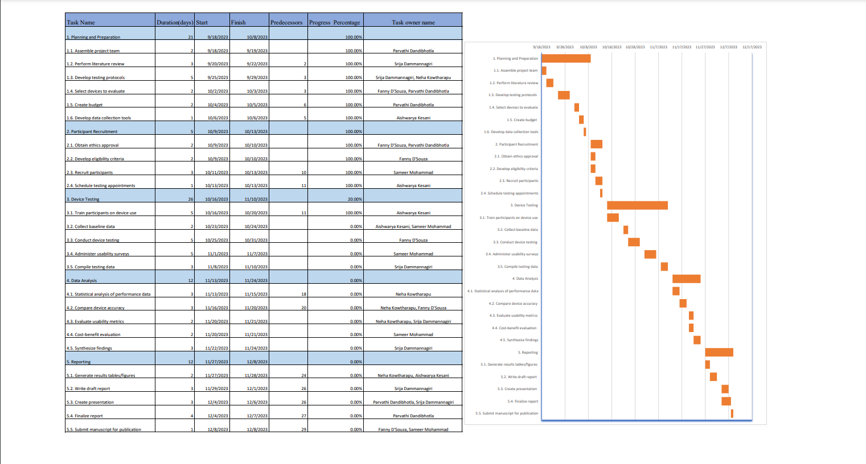
4.WORK PLAN
1.Planning and Preparation
Assembled team, performed literature review, developed testing protocols.
Selected devices, created budget, and developed data collection tools.
2.Participant Recruitment
Obtained ethics approval.
Developed eligibility criteria, recruited participants, and scheduled testing appointments.
3.Device Testing
Currently training participants, collecting baseline data, and conducting device testing.
Administering usability surveys and compiling testing data.
4.Data Analysis
Statistical analysis, comparison of device accuracy, evaluation of usability metrics.
Cost-benefit analysis and synthesizing findings.
5.Reporting
Generating results tables/figures, writing draft report, creating presentation.
Finalizing report and submitting manuscript for publication.

Slide 11
5. COMMUNICATION PLAN
INITIATION | Aligned stakeholders on project details, assembled a skilled project team and created a comprehensive plan to guide the project from initiation through execution successfully.
DESIGN AND DEVELOPMENT | Actively gather client/sponsor feedback on report drafts and interpretations; author manuscript; demonstrate results to leadership; obtain signoff on deliverables to finalize engagement.
EXECUTION AND TESTING | Focus on finalizing test designs and device selection criteria in monthly team meetings; prepare and submit ethics applications and study documents to oversight bodies in a timely manner.
CLOSING | Provide weekly updates on participant recruitment, device testing, and roadblocks; validate data quality concurrently; share monthly budget utilization reports with sponsors.

Slide 12
6. RISK ANALYSIS
Procurement delays
Recruitment challenges
Regulatory approval delays
Stakeholder participation
Budget overruns
Data security issues
Device performance variability
Resistance to change
Inaccurate data collection
Technical device issues

Slide 13
THANK YOU

